Slide 1
Web applications fundamentals
Notes:
[Mandatory Slide] This would be the introduction slide of the topic that you are covering in this subsection.
When this slide plays, you could talk about the main aim that we’d be covering in this video.

Slide 2
In this Video, we are going to take a look at…
Features of a typical web application
Request/response flow in web applications
Design of a web application
Notes:
[Mandatory Slide]
Before the start of the video, we’d like to highlight what are important topics or pointers that we’d be covering in this video. This slide would immediately follow the intro/name slide. This would just be say 2-3 points for the viewers to know what they are getting into.

Slide 3


Features of a typical web application
Cross-platform: all platforms feature a web browser
No installation: the client-side is downloaded each time the user loads the web app
No maintenance: the client-side is updated on-the fly, no need for manual installations
Segregation of technologies: client and server sides developed in different languages and frameworks
Client-side on-demand: the client part can be delivered based on user platform: this means that a web app can run on mobile devices also!
Server-side scalability: you can reach web-scale service capabilities
Network bottleneck: lack of network or network latency can prevent a smooth user interaction
Security in client-server communication: peer authentication and data encryption needed
Interaction with user’s hardware and file system: this is made difficult, for security reasons
Notes:
[Mandatory Slide]
Before the start of the video, we’d like to highlight what are important topics or pointers that we’d be covering in this video. This slide would immediately follow the intro/name slide. This would just be say 2-3 points for the viewers to know what they are getting into.

Slide 4
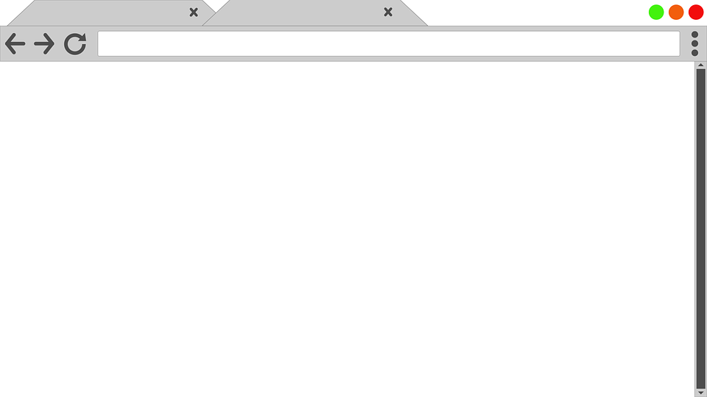


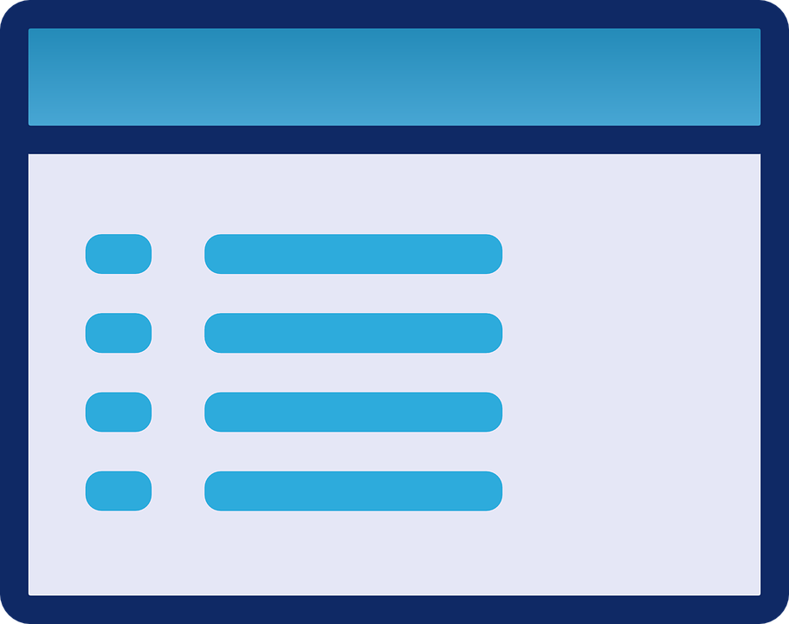






Request/response flow in web applications (1/2)
HTTP://WWW.MYAPP:COM
CALC
BROWSER
APPLICATION SERVER
WEB SERVER
Notes:
[Mandatory Slide]
Before the start of the video, we’d like to highlight what are important topics or pointers that we’d be covering in this video. This slide would immediately follow the intro/name slide. This would just be say 2-3 points for the viewers to know what they are getting into.

Slide 5
Request/response flow in web applications (2/2)
CLIENT-SIDE
SERVER-SIDE
BROWSER
APPLICATION SERVER
WEB SERVER
Notes:
[Mandatory Slide]
Before the start of the video, we’d like to highlight what are important topics or pointers that we’d be covering in this video. This slide would immediately follow the intro/name slide. This would just be say 2-3 points for the viewers to know what they are getting into.

Slide 6
Design of a web application (1/2)
A web app usually follows a N-tier architecture:
each tier is a layer implementing functionalities pertaining to a specific abstraction level within the app
the functionalities of each tier are exposed through well-defined interfaces that can be are meant to be called by the upper tiers
each tier may run on a different host or cluster of hosts
each tier may scale independently from the other ones
tier couples may be intermediated by middleware layers (eg. firewalls, proxies, caches, etc.)
1
2
3
...
N
Notes:
[Mandatory Slide]
Before the start of the video, we’d like to highlight what are important topics or pointers that we’d be covering in this video. This slide would immediately follow the intro/name slide. This would just be say 2-3 points for the viewers to know what they are getting into.

Slide 7
Design of a web application (2/2)
Usually N = 3
a Presentation Layer running on the user browser and managing the user interface in terms of user inputs, information display and possible actions to be taken
an Application Layer, where data coming from/flowing to the Presentation Layer is filtered according to specific business rules; interactions with external systems (eg. APIs) usually happen here
a Persistence Layer that deals with data modelization and data input from/output to a variety of sources (databases, file systems)
3-tiers web applications well adhere to the Model-View-Control architectural pattern (more on this in the next video)
Notes:
[Mandatory Slide]
Before the start of the video, we’d like to highlight what are important topics or pointers that we’d be covering in this video. This slide would immediately follow the intro/name slide. This would just be say 2-3 points for the viewers to know what they are getting into.

Slide 8
Summary
Features of a typical web application
Request/response flow in web applications
Design of a web application
Notes:
[Mandatory Slide]
Before the start of the video, we’d like to highlight what are important topics or pointers that we’d be covering in this video. This slide would immediately follow the intro/name slide. This would just be say 2-3 points for the viewers to know what they are getting into.

Slide 9
Using MVC frameworks
Next Video
Notes:
[Mandatory Slide]
Here the name of the next video needs to be mentioned. The narration as you guessed it would be just letting the viewer know exactly where we are at and what we’d be taking over next! ☺

